Slide 1
January 2023 | Food Service Report
Crawford Central School District

Slide 2
January is School Board Recognition Month
Thank you for all you do!
We recognize your vital role in our schools and our communities. You are extraordinary because of the countless volunteer hours you devote each year to govern your school district.
As your food service provider, we applaud you for the time and dedication you devote to assure that the children in your community are receiving the best possible education.
We appreciate you and thank you for the opportunity to serve your district!
Notes:
Link at top is to create new QR code. Picture on computer screen needs changed.

Slide 3
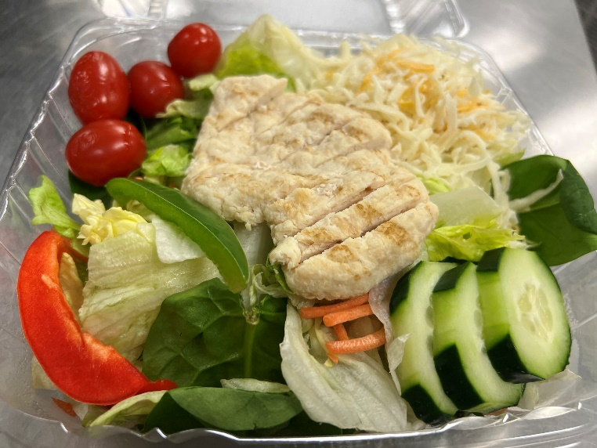
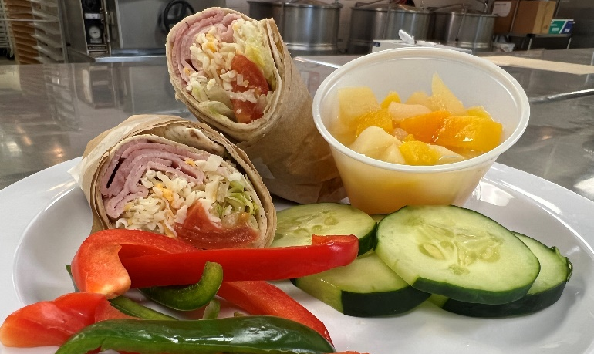
TNG On-Site at CCSD
Secondary School Lunch Options
Homemade Pepperoni Pinwheels are Featured Tuesday’s and Thursday’s
Fresh Made Grab and Go Salads are offered daily at our secondary schools. Chicken, Chef and Vegetarian options are available.
Students looking for a lighter grab-n-go meal option can snatch a wrap or hoagie!

Slide 4
Impacts of Post-Pandemic on Participation
Latest updates on your program’s performance
Students at Meadville Sr High School look forward to Churro Day in the Snack Room!
 | Budget | Actual
Breakfast | 1,011 | 1,316
Lunch | 1,576 | 2,040
Ala-Carte | $495 | $661

Slide 5
Supply Chain Updates and Industry Trends
News from the TNG Purchasing Team
Product availability and pricing, primarily of steel and tin cans, plastic, paper products, wheat, chicken, beef, sugar and corn continue to be the purchasing team’s focus.
While we are seeing signs of recovery in some areas, we continue to adjust as needed to ensure a balance of quality, nutrition and cost effectiveness.
We’ve recently launched a weekly internal publication featuring guidance that provides tips for your Director of Food and Nutrition to streamline kitchen processes, ultimately promoting time and cost savings.
The purchasing team is currently planning broker showcases, where our vendors introduce new food products. From there, we choose designated locations for students to taste test, which helps our chefs determine future menu items.
Notes:
Link at top is to create new QR code. Picture on computer screen needs changed.

Slide 7
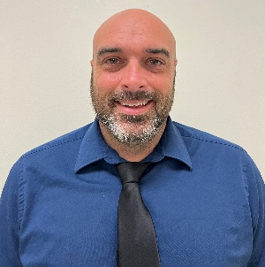
Thank You!
Your Food Service Team:
Tammy Groover
Food Service Director
814-336-1121 Ext. 130
tammy.groover@craw.org
crawford@thenutritiongroup.biz
Follow us on:
Travis Weese
Food Service Director
814-336-1121 Ext. 130
Travis.weese@craw.org
crawford2@thenutritiongroup.biz
@TheNutritionGroup
@TNG_Corporate
@TheNutritionGroup
Katie Baldwin
Regional Manager
814-397-6696
kbaldwin@thenutritiongroup.biz

