Slide 1
February 2023 | Food Service Report
Crawford Central School District

Slide 2
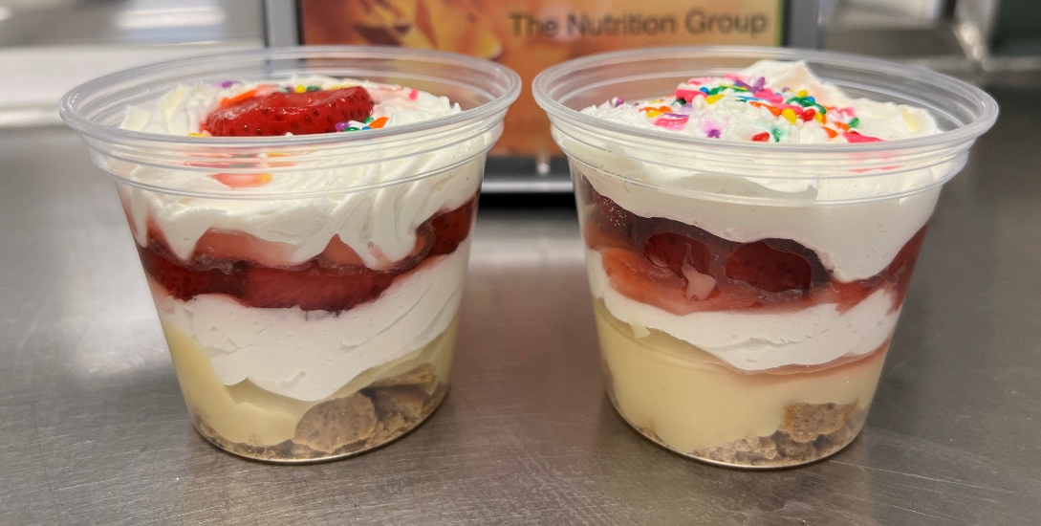
Post-Pandemic Impact on Participation
Participation Statistics
 | Budget | Actual
Breakfast | 1011 | 1254
Lunch | 1576 | 1950
Ala-Carte | $495 | $631
Strawberry Pie Pudding Parfait’s made an appearance in the Meadville Area Sr High and Meadville Area Middle Schools snack areas as a special a la carte item!
Crawford Central has served over 367,000 meals so far this year!

Slide 3
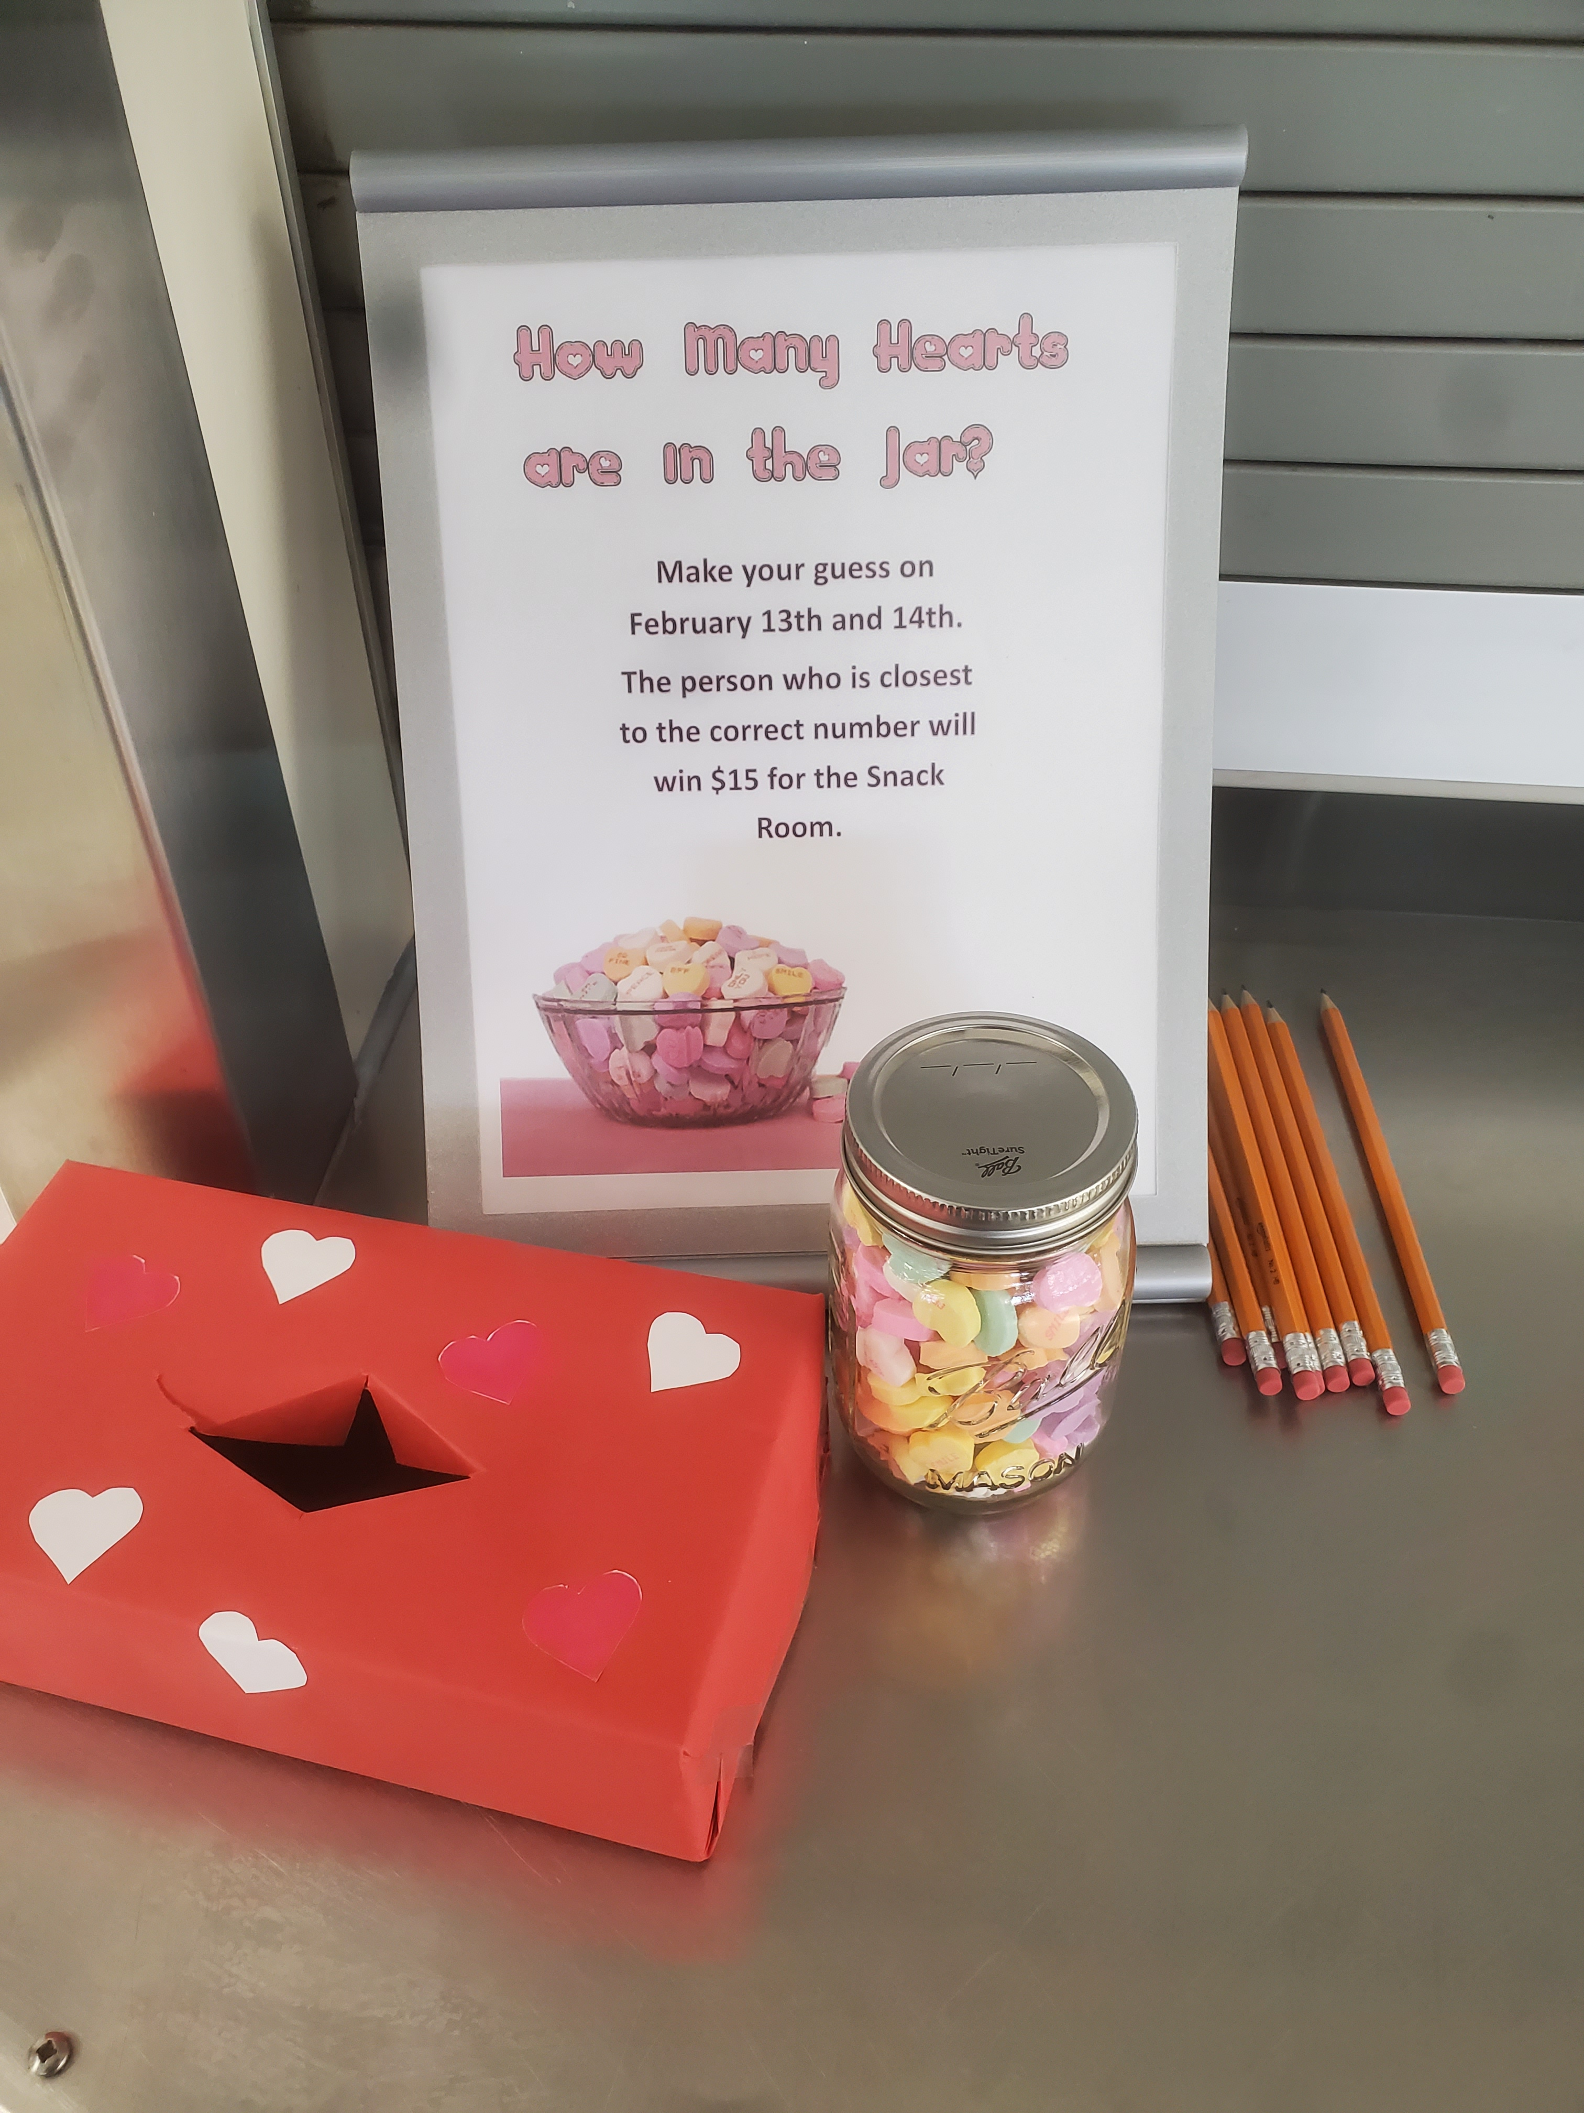
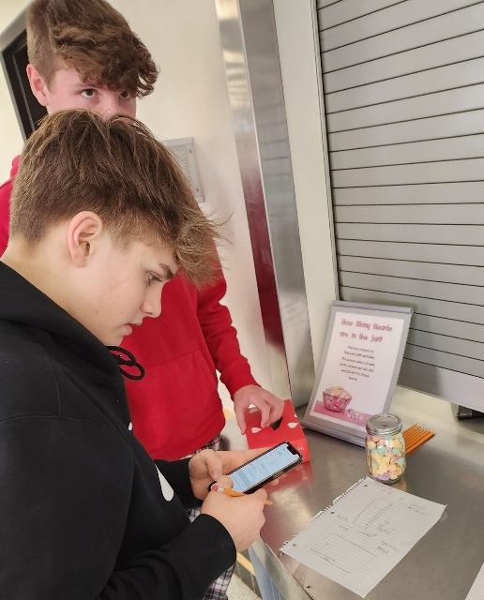
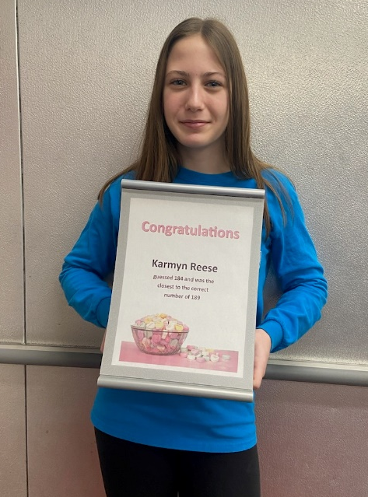
Valentine's Day
Guess the Hearts
We held a contest at the High Schools and Middle School to see who could guess how many Candy Hearts were in a jar. We received hundreds of guesses and two of the schools had multiple people get within one of the correct answer. Crawford Central served over 1,800 secondary lunches on these two days!

Slide 4
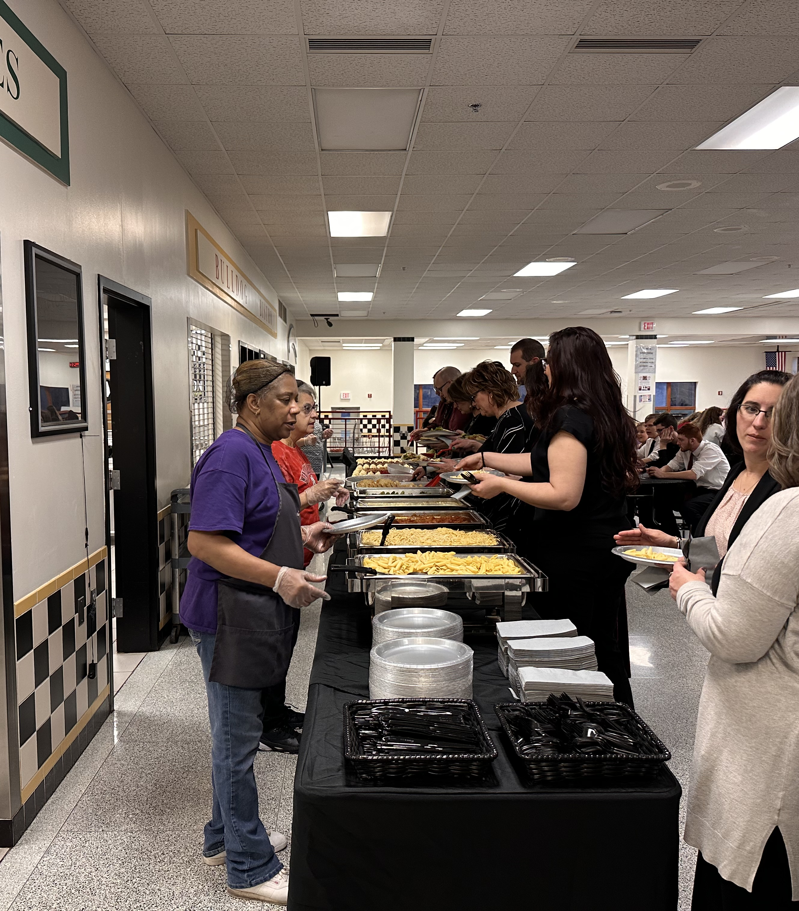
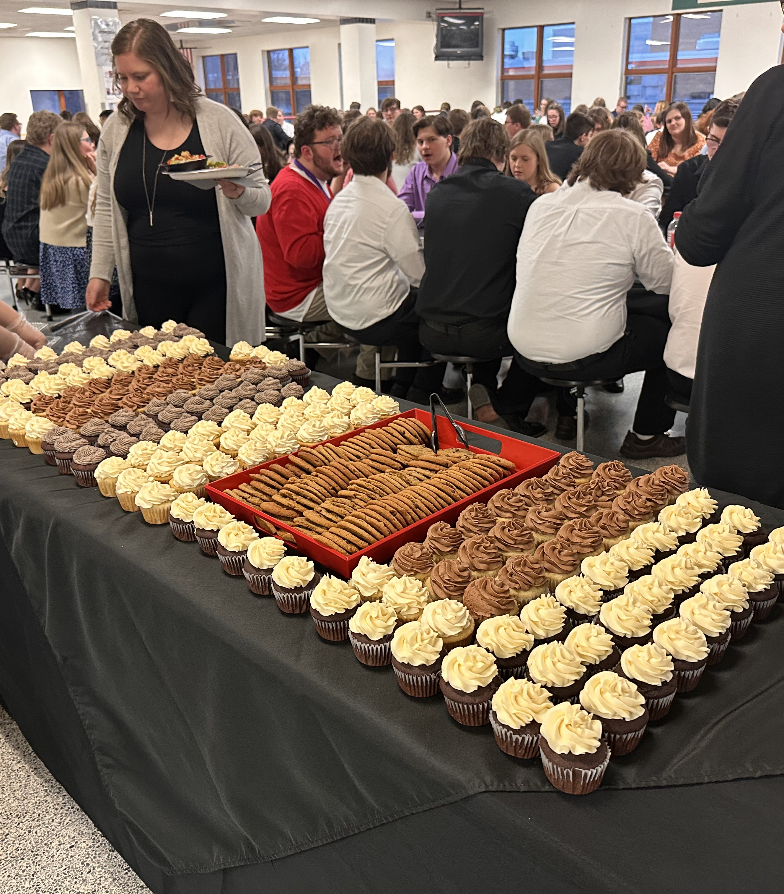
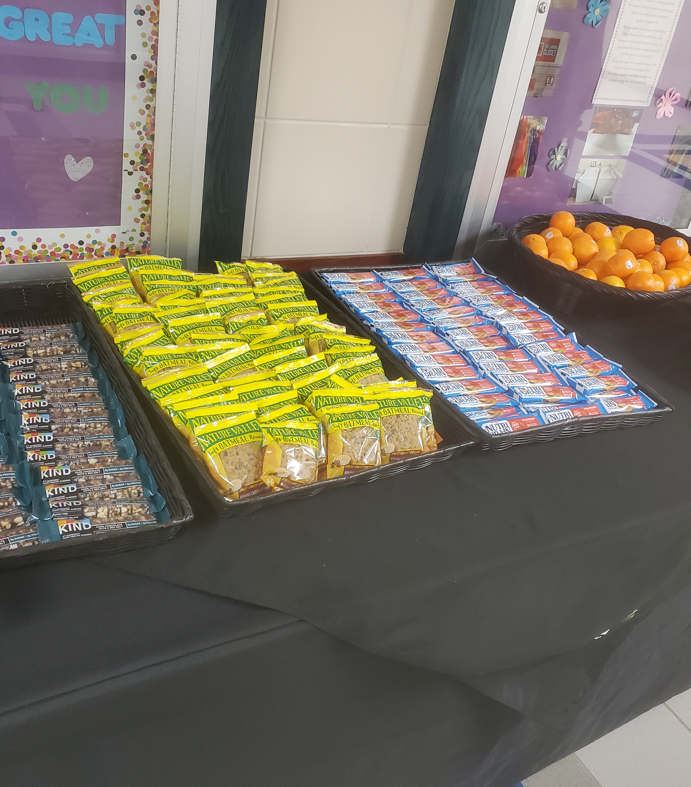
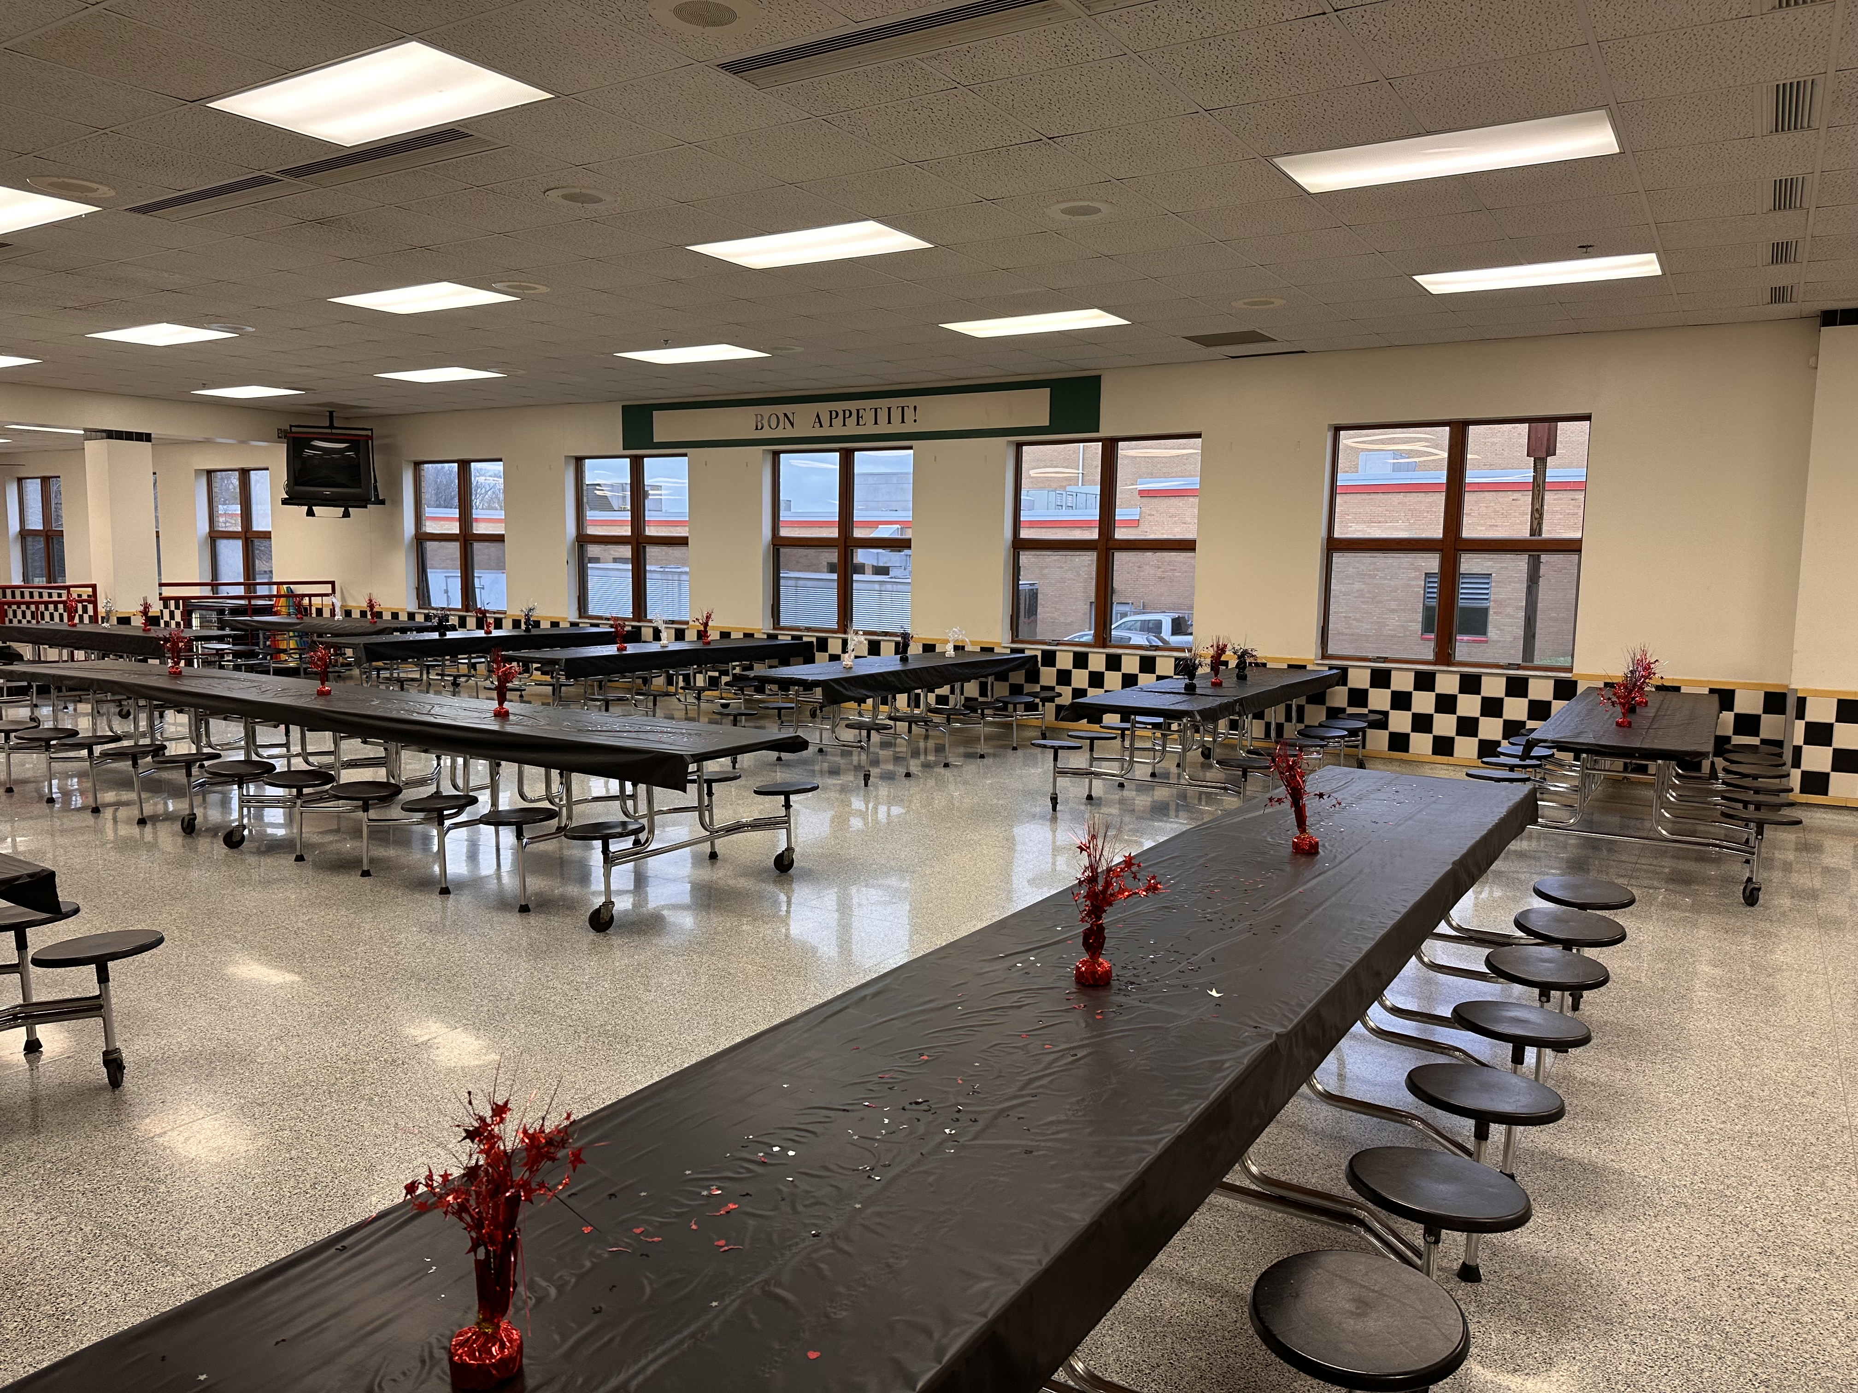
PMEA Choir
The PMEA Regional Choir held and event at MASH. For two days we provided Breakfast, Snacks, Lunches, and Dinners for the students and Directors.

Slide 5
February is American Heart Month
School Lunch and Breakfast promote heart health every day

Slide 6
“DIG IN to School Breakfast!”
National School Breakfast Week is around the corner!

Slide 7
Industry Outlook
What’s Happening in the News

Slide 10
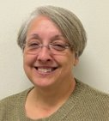
Thank You!
Your Food Service Team:
Tammy Groover
Food Service Director
814-336-1121 Ext. 130
tammy.groover@craw.org
crawford@thenutritiongroup.biz
Follow us on:
Travis Weese
Food Service Director
814-336-1121 Ext. 130
Travis.weese@craw.org
crawford2@thenutritiongroup.biz
@TheNutritionGroup
@TNG_Corporate
@TheNutritionGroup
Katie Baldwin
Regional Manager
814-397-6696
kbaldwin@thenutritiongroup.biz

